Slide 1






https://bit.ly/3XfUGw2
TITLE: DATA SCIENCE TASK AUTOMATION AI BOT
Hackathon Project

Slide 2



Objective
Automate repetitive data science tasks
Improve efficiency and reduce human error
Allow data scientists to focus on high-level decision-making

Slide 3
Problem Statement
Data scientists spend 60-80% of their time on
data preprocessing and cleaning
Manual feature engineering and model evaluation
slow down innovation
Need for an AI-driven automation tool to streamline workflows

Slide 4


Technical Details
#02
Supports automation of data cleaning, visualization, and modeling
#01
#03
Python, Streamlit, Pandas, Matplotlib, Seaborn, Plotly, Scikit-learn
Hugging Face API for model deployment

Slide 5



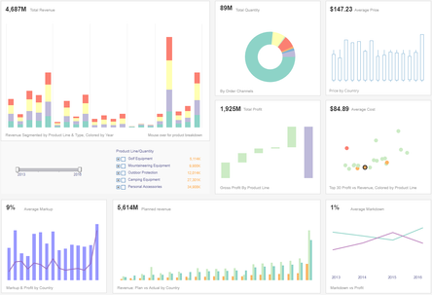
Innovation
Unlike traditional data science workflows that require programming expertise, this project offers a no-code interactive solution. Users can upload their datasets and receive instant insights and model predictions, making data science more accessible and efficient.
One-click data preprocessing and model training
AI-assisted feature selection and hyperparameter tuning
Interactive dashboard for seamless user experience

Slide 6



Prototype
#01
Upload datasets and clean them with a single click
A fully functional Streamlit web application that allows users to:
#02
Perform data visualization using interactive plots
#03
Train and compare multiple machine learning models
#04
Identify the best-performing model automatically

Slide 7




SDGs
A Data Science Task Automation AI Bot aligns with Sustainable Development Goal (SDG) 9:
(SDG) 9 :Industry, Innovation, and Infrastructure because it enhances efficiency, innovation, and automation in data science processes, contributing to technological advancement and smart industry practices.
Additionally, depending on the application, it can also align with:
SDG 8: Decent Work and Economic Growth – By improving productivity and enabling data-driven decision-making.
SDG 4: Quality Education – If used for automated insights in educational research.
SDG 3: Good Health and Well-being – If applied in healthcare analytics.

Slide 8
Impact and Scalablity
This project enhances efficiency and accessibility in data science by:
Efficiency Enhancement
Automated Insights
Scalable Solutions
Reducing manual effort in data processing
Enabling quick insights through automation
Providing a scalable architecture that can be expanded with more features, models, and cloud integration

Slide 9

Conclusion
Data Science Task Automation streamlines data preprocessing, analysis, and model selection, making machine learning workflows more efficient and user-friendly. With its interactive and automated approach, it is a powerful tool for data-driven decision-making and can be expanded for broader applications in the future.

Slide 10

Team members:
https://bit.ly/3XfUGw2
Komal
Ali Athar Khan
Ayesha Arshad
Umer Farooq
Muhammad Mateen

Slide 11


THANK YOU!
https://bit.ly/3XfUGw2z

